Slide 1
BUS RESERVATION SYSTEM
Submitted in the partial fulfillment for the award of the degree of
BACHELOR OF ENGINEERING
IN
CSE(H) BIG DATA ANALYTICS
Submitted by:
YASH SRIVASTAVA
20BCS4443
Under the Supervision of:
Dr Vipin Tiwari
Department of AIT-CSE
DISCOVER . LEARN . EMPOWER

Slide 2
Outline
Introduction to Project
Problem Formulation
Objectives of the work
Methodology used
Results and Outputs
Conclusion
Future Scope
References

Slide 3
Introduction to Project
The focus of the project is to computerize traveling company to manage data, so that all the transactions become fast and there should not be any error in transaction like calculation mistake, bill generation and other things. It replaces all the paper work. It keeps records of all bills also, giving to ensure 100% successful implementation of the computerized Bus reservation system.
This reservation system has three modules. First module helps the customer to enquire the availability of seats in a particular bus at particular date. Second module helps him to reserve a ticket. Using third module he can log out from the console.

Slide 4
Problem Formulation
Bus Reservation Systems that were suggested till now, are not up to the desired level. There is no single system which automates all the process.
In order to build the system, all the processes in the business should be studied, System study helps us under the problem and needs of the application. System study aims at establishing requests for the system to be acquired, development and installed. It involves studying and analyzing the ways of an organization currently processing the data to produce information.

Slide 5
Analyzing the problem thoroughly forms the vital part of the system study. In system analysis, prevailing situation of problem is carefully examined by breaking them into sub problems.
Problematic areas are identified and information is collected. Data gathering is essential to any analysis of requests. It is necessary that this analysis familiarizes the designer with objectives, activities and the function of the organization in which the system is to be implemented.

Slide 6
Objectives
The main objective of the Project on Bus Ticket Booking System is to manage the details of Bus, Tickets, Booking, Customer, Seats. It manages all the information about Bus, Seats, Bus. The project is totally built at administrative end and thus only the administrator is guaranteed the access. The purpose of the project is to build an application program to reduce the manual work for managing the Bus, Tickets, Booking. It tracks all the details about the Booking, Customer, Seats.

Slide 7
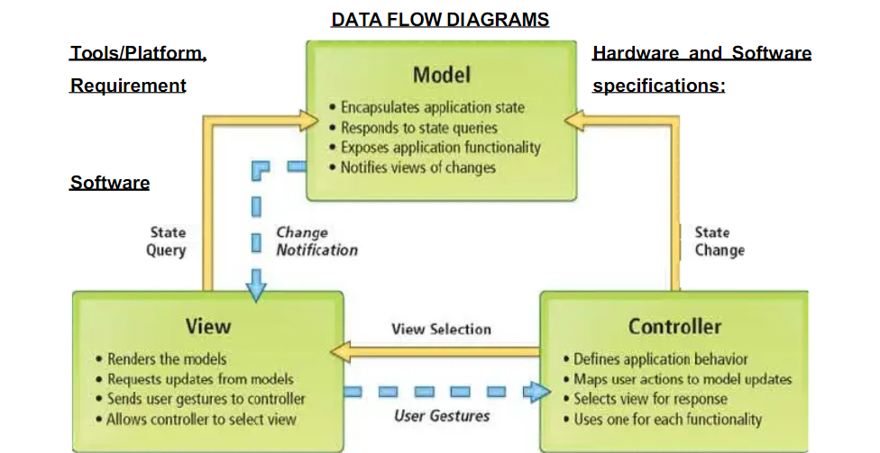
Methodology used

Slide 8
Methodology used
ALGORITHM:
Taking a class named as Bus.
Declaring the variables and arrays as Pessenger Name[99], deprt[9], from[9], to[9], arriva[9].

Slide 9
And in public of the class we are giving member functions as
void Bus_Registration();
void show();
void book();
void exit();

Slide 10
And giving that maximum buses available are 10.
Ans now we create a another class allBusDetails to save the details of bus.
And now with respect to Bus Registration function we gave few options to enter in the run time which will gives to enter the bus details from back end of the system like bus no, Arrival time, Departure time, from and to, Total Seats .

Slide 11
And the show function shows that the how many buses are available . And the total seats are in the buses.
And the Exits Function is used to give normal termination of a program without performing any cleanup tasks.

Slide 12
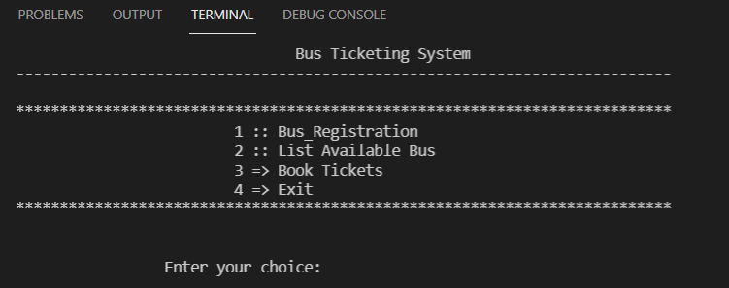
Results and Outputs
The first look of the out put will be given as

Slide 13
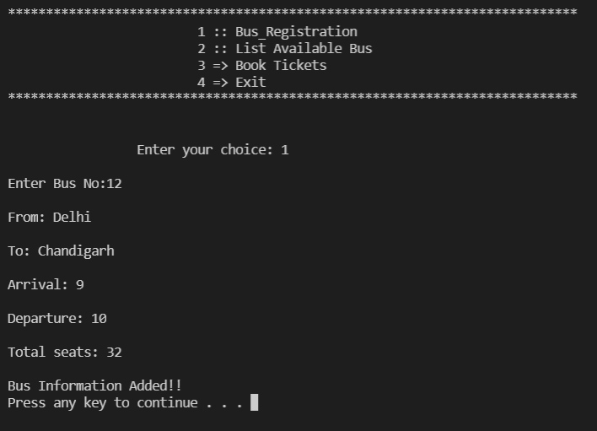
Second step is that we have to install the number of busses that we have to provide for customers and this is done by the back end system and in this function we have to give details of the bus like bus num, Arrival time ,departure time, From and To.

Slide 14
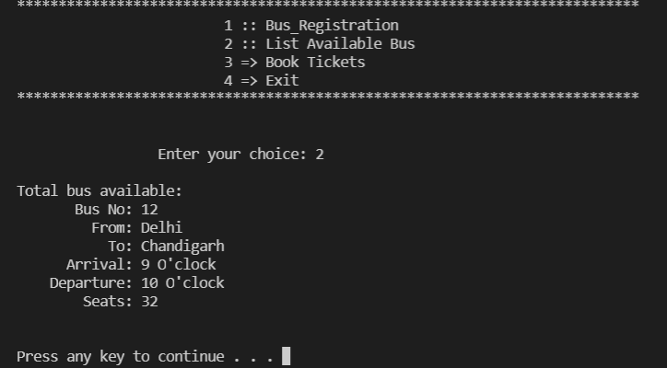
Third step is that We have to show the user how many busses are available in this travels that’s why we have to display the busses and their routes and total number of seats in buses.

Slide 15
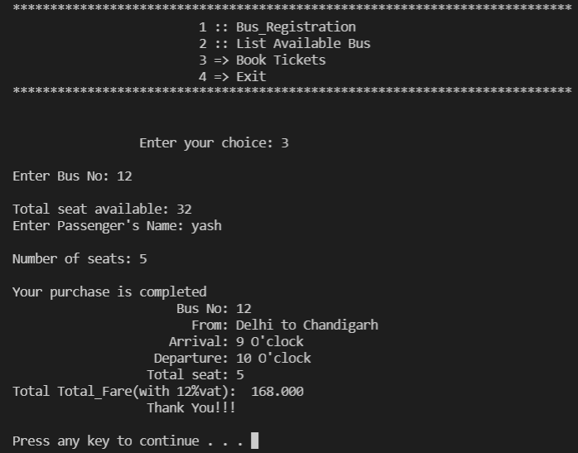
After checking the routes, number of tickets and the busses in the travels we have to book the ticket for the passenger and show the total fare with 12% vat.

Slide 16
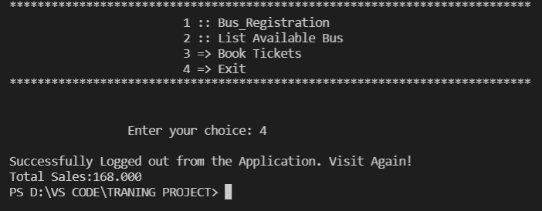
Now after all these conclusions we have to show them total sales .

Slide 17
Conclusion
This facility is helpful for the users and the organization as well. This is a simple yet effective technology which helps the users to access the service concurrently from different places.
Advantages:
a) It reduces the burden of the administrator to maintain numerous data of passengers.
b) It reduces wastage of time as it is fast and simple.
c) It is low cost.
d) Improves the efficiency of the organization.

Slide 18
Future Scope
It may help collecting perfect management in details. In a very short time, the collection will be obvious, simple and sensible. It will help a person to know the management of passed year perfectly and vividly. It also helps in current all works relative to Bus Ticket Booking System. It will be also reduced the cost of collecting the management & collection procedure will go on smoothly.

Slide 19
References
Google for program solving
https://www.tutorialspoint.com
Let Us C++ by Yashavant Kanetkar

